Slide 1
SCSI1113: COMPUTATIONAL MATHEMATICS
CHAPTER 5
Introduction to Numerical Methods
(Error & Accuracy)
2014/2015 – Semester 2

Slide 2
Introduction
Computational Mathematics has been used since more than 3700 years ago by Babylon tribe to get solution of quadratic equation and square root of n integer.
Computational Mathematics involves calculation of numerical solution for problems that can be expressed in mathematical form.
This kind of problems that involved various fields usually can only be solved using numerical method.
Nevertheless, Computational Mathematics involves more complex calculation to get more accurate answer compared to original mathematical method that use easier method, and also give more exact solution.
Problem solving for original mathematical is performed analytically and limit only to certain problems only.

Slide 3
Problem Solving in Computational Mathematics
Problems in mathematic such as complex integration, calculation certain value that is not provided in the data series in a table and linear systems require a solution using numerical method.

Slide 4
Example 1
Integration of
is easy to evaluate but integration of
is difficult to evaluate and require numerical method.

Slide 5
Example 2
An experiment is conducted to determine velocity of an object in a certain interval. The experimental results is given in Table 1.
Table 1
Time, t (s) | 0.0 | 1.0 | 2.0 | 3.0
Velocity, v (m/s) | 0 | 0.5 | 1.0 | 1.5
To find the velocity at t = 2.7 is difficult because the data not shown in the table.
Therefore, numerical method is required to solve the problem.

Slide 6
Example 3
The following linear system can be solved using linear system solution technique.
2x + y = 4
4x + 2y + 2z = 16
2x + 3y + z = 4
Most mathematical problem in real world involves more that three equation. Number of equation to be solved may reach more than hundred thousand. The best solution to solve the problem is using numerical method with the assistance of computer.
Numerical method is a field that involved applied mathematical in representing and solving mathematical problem. This problem use step of works that involve operation of numbers. It is important to know the exact mathematical solution. High accuracy of answer can be obtained through advanced calculation.

Slide 7
Accuracy
In numerical method, if the correct calculation method is chosen to solve the problem, the accuracy of answer is affected by two factors namely mistake and error.
Mistake
Two source of mistake are from human carelessness and technical error by machine or computer.
Error
Error occurs due to approximation process. The error is because of limitation in the power of human and machine. Error by human can be overcome but not the error by machine.

Slide 8
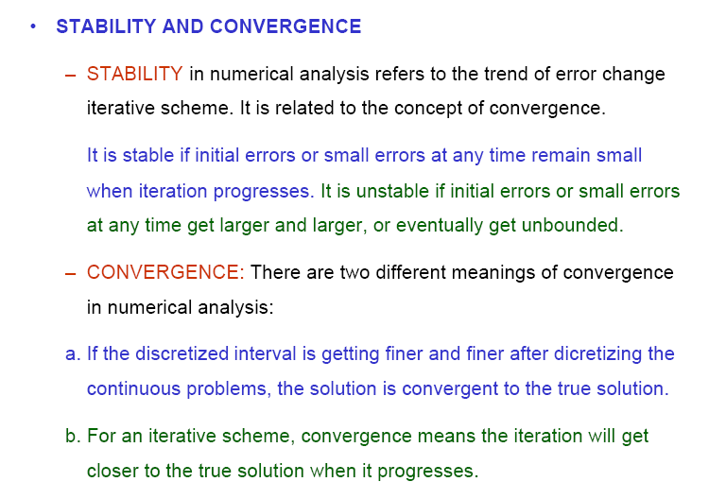
Stability & Convergence

Slide 9
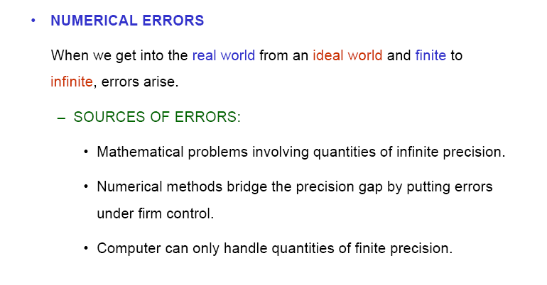
Numerical Errors

Slide 10
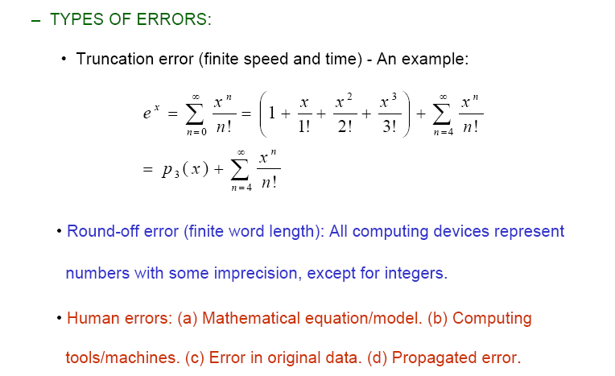
Types of Errors

Slide 11
Types of Errors (cont.)
Data Error
Data error is because numbers used in the experiment or calculation is measured at certain accuracy or decimal points. For example, if the volume of a sphere is 6.24 ml3 , so the result contains error. This is because volume of sphere is true only at 2 decimal points.
Error in Method/Rounding
Numerical method involves many infinite series in calculation to derive the approximation of the exact value. Only part of the expression in the infinite series is utilised and this lead to the error in method.
Rounding Error
A floating number that contains many decimal points or infinite decimal points can be rounded to certain decimal point but it involves error. Rounding error is the difference between the rounded value and actual value. For example, if 1.67777777….. is rounded to 4 decimal points will give value 1.6778.

Slide 12
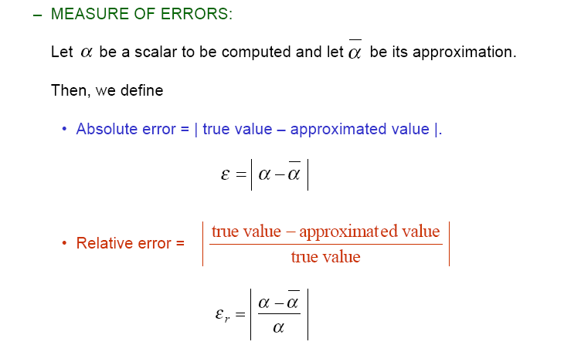
Measure of Errors

Slide 13
Error, Modulus Error and Relative Error
Let, N is an exact value and n is an approximate value. Error is a difference between exact value and approximate value and is represented as ε:
where,
N: exact value ; n: approximate value; ε: error
Sign for error value is not important. Modulus is used to show that error is always positive. This value is called modulus error or absolute error, |ε|.
|ε| = | exact value – approximate value |
|ε| = | N – n |

Slide 14
Error, Modulus Error and Relative Error (cont.)
Ratio for error is called relative error and is expressed as:
, or
Because of its exact nature, in general N is known, therefore
For calculation purpose, relative error will give more accurate result compared to the error itself.

Slide 15
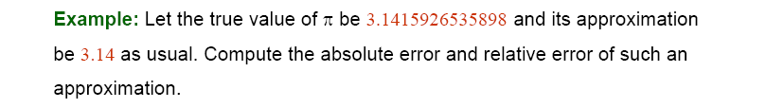
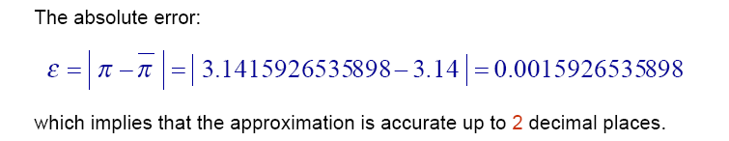
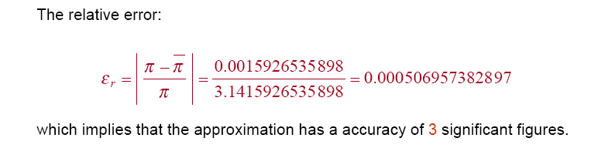
Example 4

Slide 16
Example 5
Find the error value and relative error for the following:
a) N=3.141592 and n=3.14
|e| = | 3.141592 – 3.14 | = 0.001592
N=1 000 000 and n=999 996
|e| = | 1 000 000 – 999 996 | = 4 ;
N=0.000012 and n=0.000009
|e| = | 0.000012 – 0.000009 | = 0.000003 ;

Slide 17
Example 5 (cont.)
Example 5(a), no big difference between error value and relative error. Therefore, either error value or relative error can be used to determine the accuracy of approximate value, n.
Example 5(b), N value is in magnitude 10⁶ and the resulted error is big but the relative error is small. This show that approximate value(n) may be good approximate to the exact value, N.
Example 5(c), with magnitude 10⁻⁶, resulted error is the smallest between among three examples but the resulted relative error is the biggest among three examples. Percentage of relative error in 5(c) is 25% and this show that approximate value (n) is not good approximate for N.
We can see that when |N| move far from 1 (bigger or smaller), value of relative error is better approximate to the accuracy of approximate value.

Slide 18
Maximum Modulus for Rounding Error
If a number is rounded to n decimal points, so its error satisfies the inequality:
, or

Slide 19
Example 6
Given a number rounded to 2 decimal points, the relative error is:
=

Slide 20
Effect of Rounding Error in Addition and Subtraction
Given n₁, n₂ are approximate value of two quantities, N₁, N₂. Error are ε₁, ε₂ where ε₁ = N₁ – n₁ and ε₂ = N₂ – n₂
If N₃ is total for exact value, so
N₃ = N₁ + N₂
Total of approximate value, is given by
n₃ = n₁ + n₂
From Equation (1.1) we obtain
ε₃ = N₃ – n₃
= (N₁ + N₂) – (n₁ + n₂)
= (N₁ – n₁) + (N₂ – n₂)
= ε₁ + ε₂

Slide 21
Effect of Rounding Error in Addition and Subtraction (cont.)
For any two numbers, a and b, the inequality is given by
|a ± b| ≤|a| + |b|
From (1.7) and (1.8) we obtain
|ε₃| ≤|ε₁|+|ε₂|
If ε₃ is exact difference between error ε₁, ε₂, so we can show that
ε₃ = ε₁ – ε₂
We can conclude that modulus error from addition or subtraction of two values is less or equal with total modulus for each value.

Slide 22
Example 7
Find the most accurate value of the following operation:
3.69 + 5.432 – 2.37 – 3.5214
where each number has been rounded to their decimal points.
Solution:
Exact calculation gives result as follow:
3.69 + 5.432 – 2.37 – 3.5214 = 3.2306
Modulus error is given by,
|ε₃|≤0.005 + 0.0005 + 0.005 + 0.00005 = 0.01055
Therefore, the result is between
3.2306 + 0.01055 and 3.2306 - 0.01055
3.24115 and 3.22005
Both of these values are same if rounded to 1 decimal point. Therefore, the best approximate value is 3.2 (1 decimal point).

Slide 23
Example 8
Find the most accurate value of the following operation
1.172 – 0.95 + 6.3434 – 1.383
where each number has been rounded to their decimal points.
Solution:
Exact calculation gives result as follow:
1.172 - 0.95 + 6.3434 - 1.383 = 5.1824
Modulus error is given by,
|ε₃|≤ 0.0005 + 0.005 + 0.00005 + 0.0005 = 0.00605
Therefore, the result is between
  5.1824 + 0.00605 and 5.1824 – 0.00605
5.18845 and 5.17635
Both of these values are same if rounded to 1 decimal point. Therefore, the best approximate value is 5.2 (1 decimal point)

Slide 24
Exercise # 1
The volatge in a high-voltage transmission line is stated to be 2.4 MV while the actual voltage may range from 2.1 MV to 2.7 MV. What is the maximum absolute and relative error of voltage?

Slide 25
Exercise # 2
Find the most accurate value for the following operation, where each number has been rounded to a certain decimal point,
3.314 + 2.0008 + 4.15 – 1.07

Slide 26
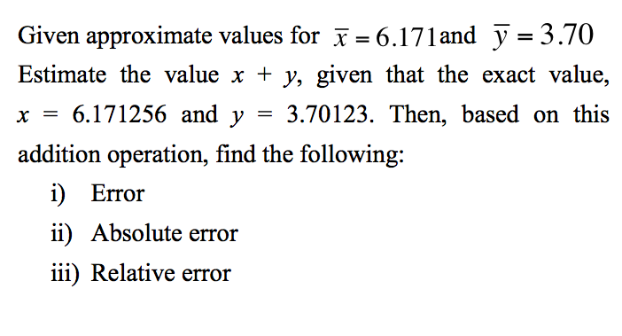
Exercise # 3

